Slide 1
OneTracker
Team Pikachu
By Chen Zhengjie, Kris Huang Wei, Edison Koh, Fu Guanqiao, Liu Fenghao, Tan Li Ying

Slide 2
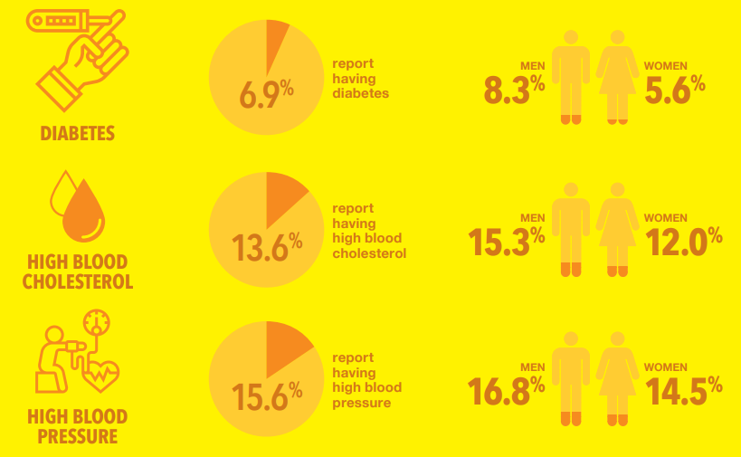
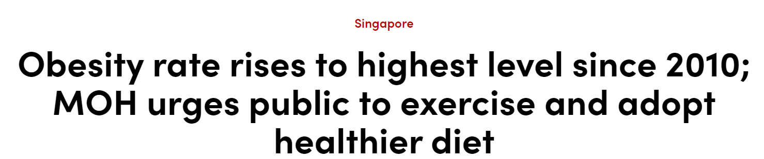
Problems we notice (lifestyle related)
Notes:
https://www.moh.gov.sg/docs/librariesprovider5/default-document-library/hpb_nphs_a4infographics.pdf
https://www.channelnewsasia.com/singapore/obesity-rate-rises-highest-level-2010-moh-urges-public-exercise-and-adopt-healthier-diet-2322321

Slide 3
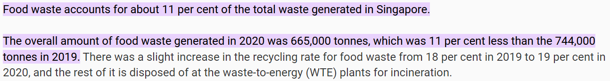
Problems we notice (Food Wastage)
Notes:
https://www.nea.gov.sg/our-services/waste-management/3r-programmes-and-resources/food-waste-management#:~:text=Food%20waste%20accounts%20for%20about,the%20744%2C000%20tonnes%20in%202019.

Slide 4
Requirements elicition
Application must be able to assist people in monitoring their food consumption
Must be able to inform user about the nutrition information of items they purchase and consume
Application must help people to reduce their food wastage
Must keep track of items they have already bought
Must keep track of item purchase date to prevent food going bad

Slide 5
The project is successful when users are able to monitor their purchase and consumption habits.
This project will be the best companion of users who are eager to maintaining a healthier lifestyle.
Vision

Slide 6




Money Saver
Life Saver
Our product
OneTracker

Slide 7
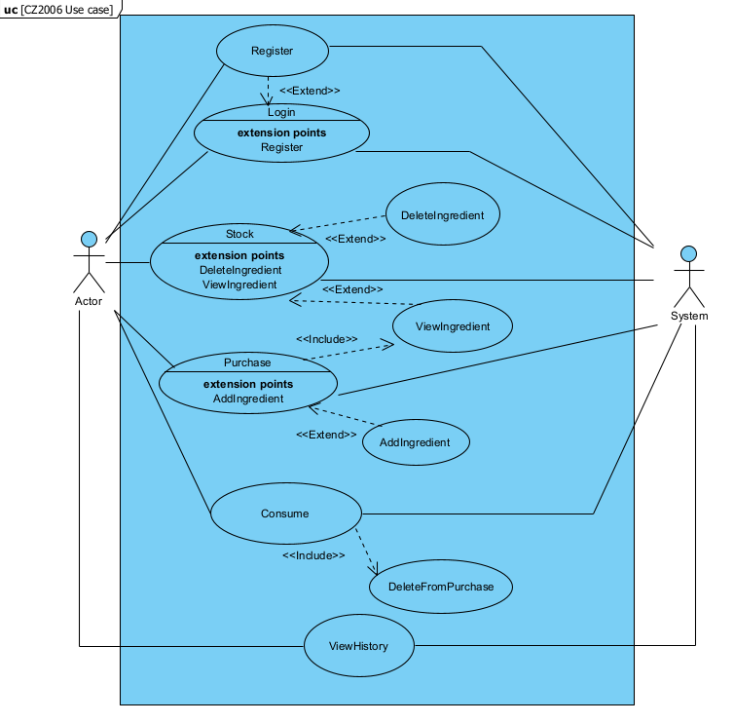
Use Case Diagram

Slide 8
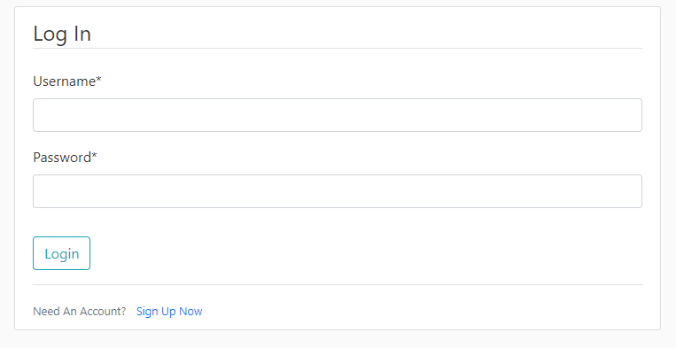
Use Case Diagram(focus)

Slide 9
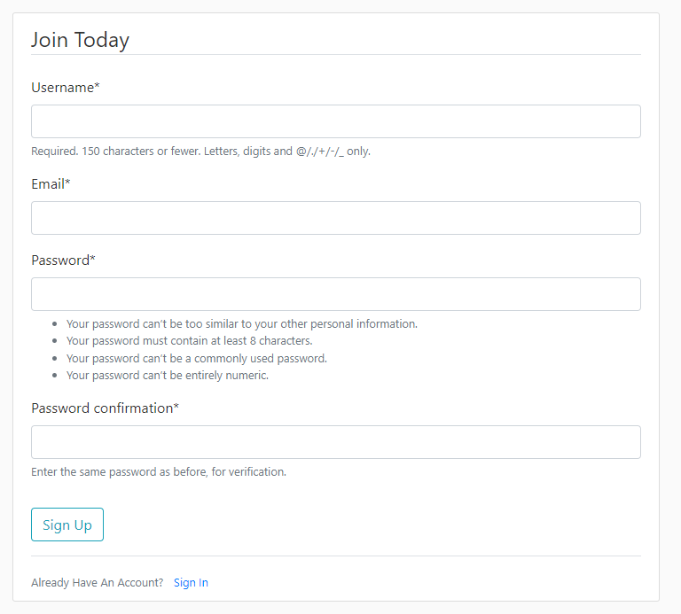
Use Case Diagram(focus)

Slide 10
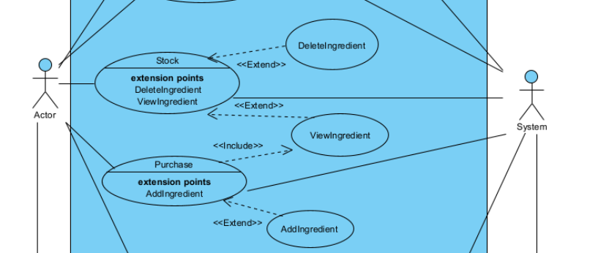
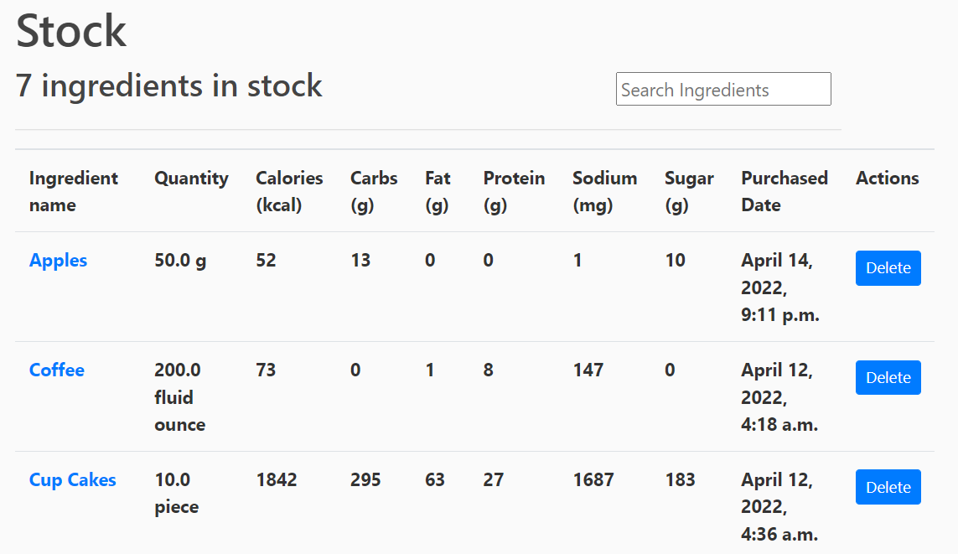
Use Case Diagram(focus)

Slide 11
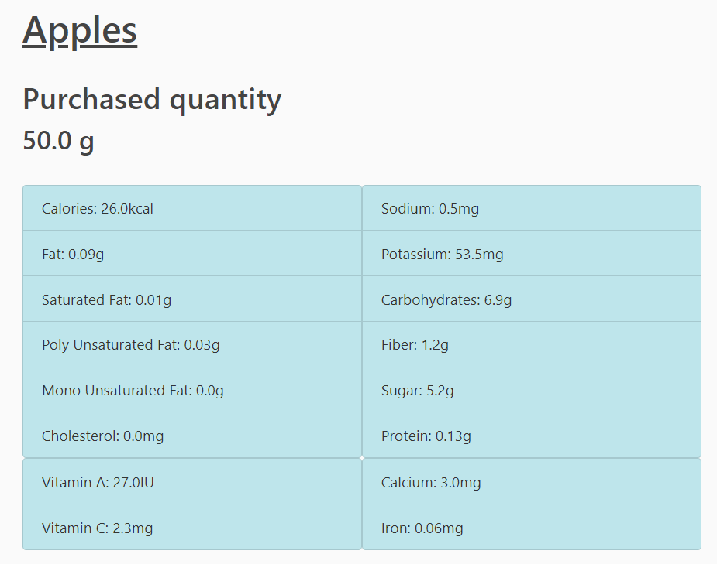
Use Case Diagram(focus)

Slide 12
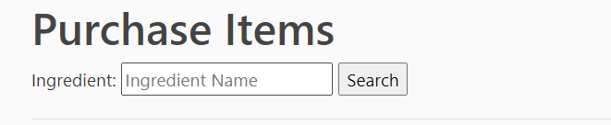
Use Case Diagram(focus)

Slide 13
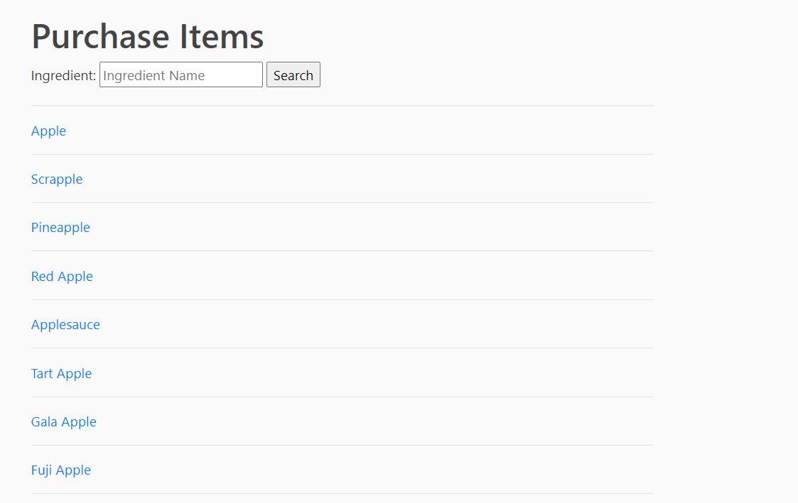
Use Case Diagram(focus)

Slide 14
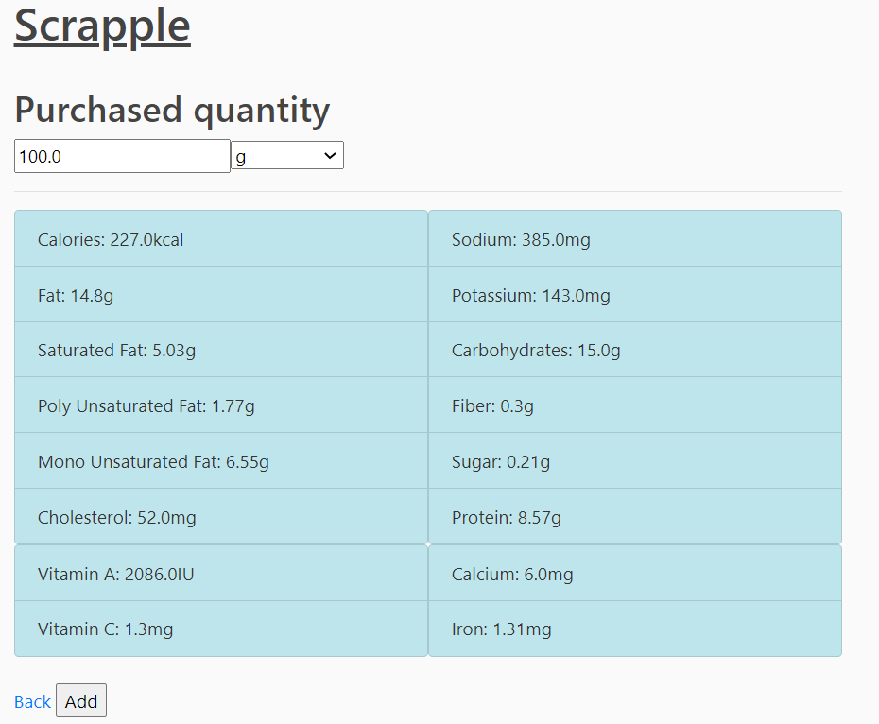

Use Case Diagram(focus)

Slide 15
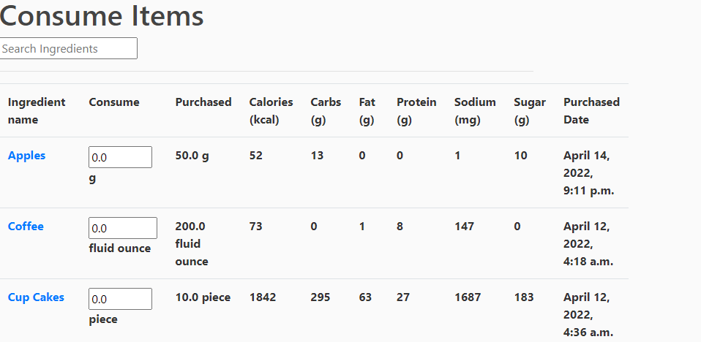
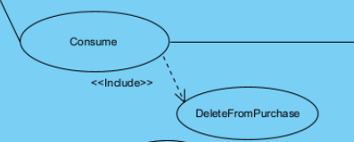

Use Case Diagram(focus)

Slide 16
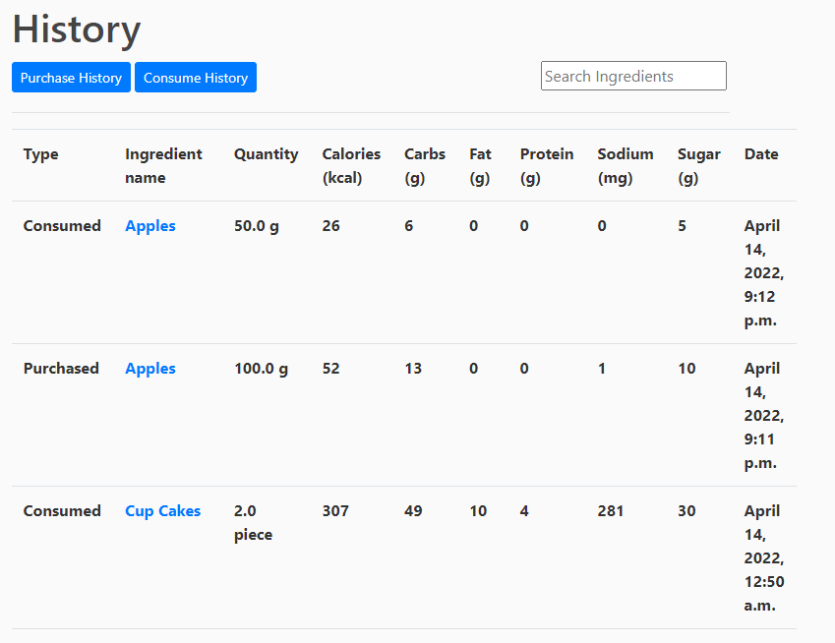

Use Case Diagram(focus)

Slide 17
Product Demo
https://onetracker.herokuapp.com/

Slide 18
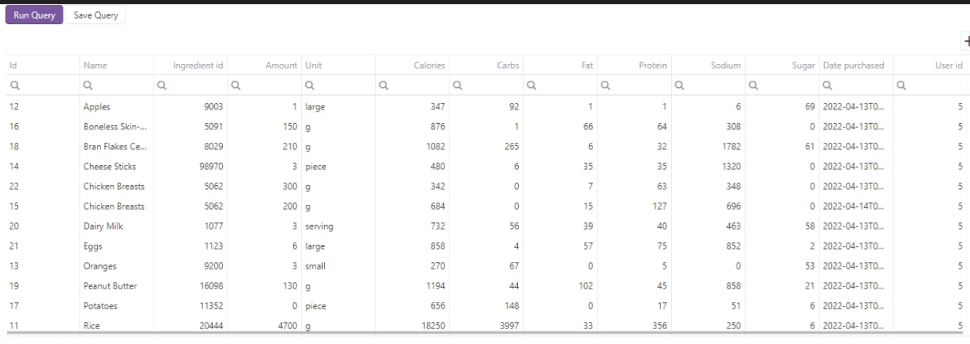
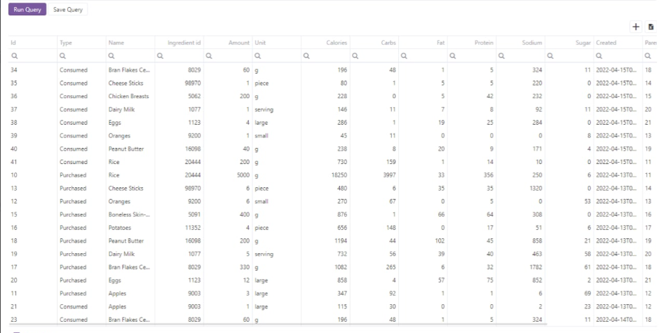
Database deployment: PostgreSQL
Stock query set
IngredientHistory query set

Slide 19

Cloud platform deployment
We used cloud service platform heroku to deploy our application

Slide 20
Software Practices

Slide 21
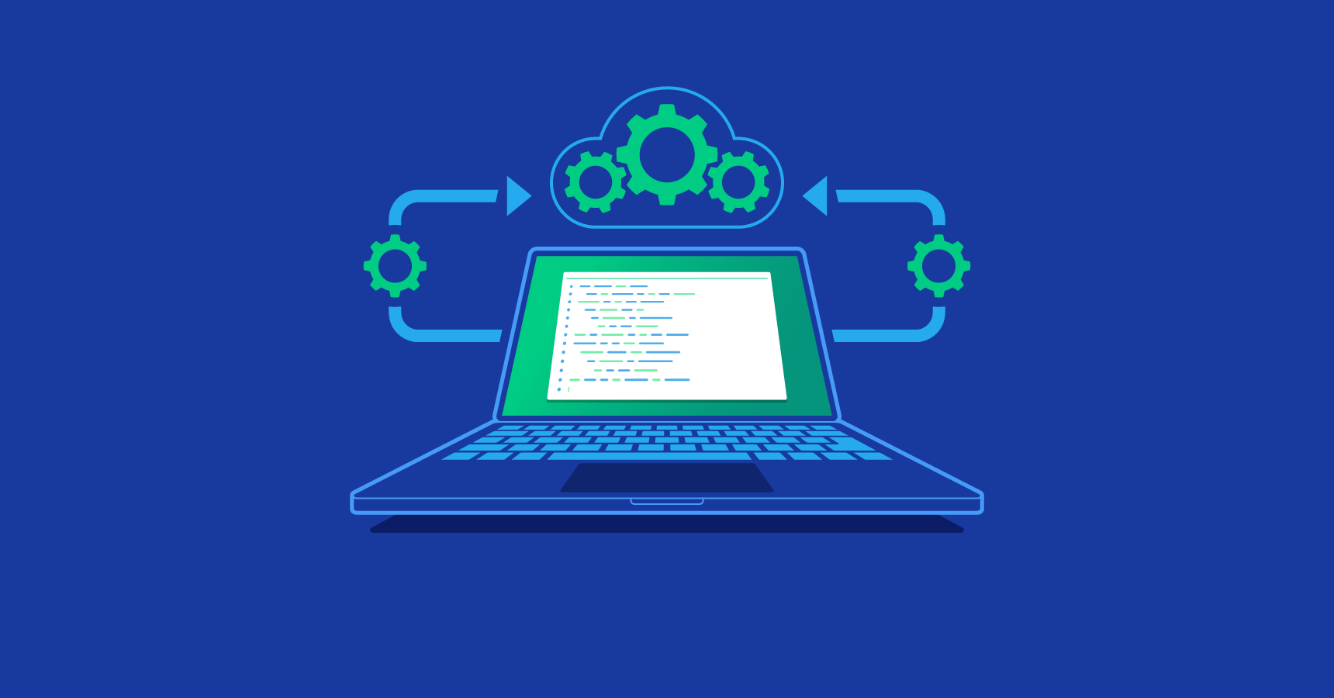
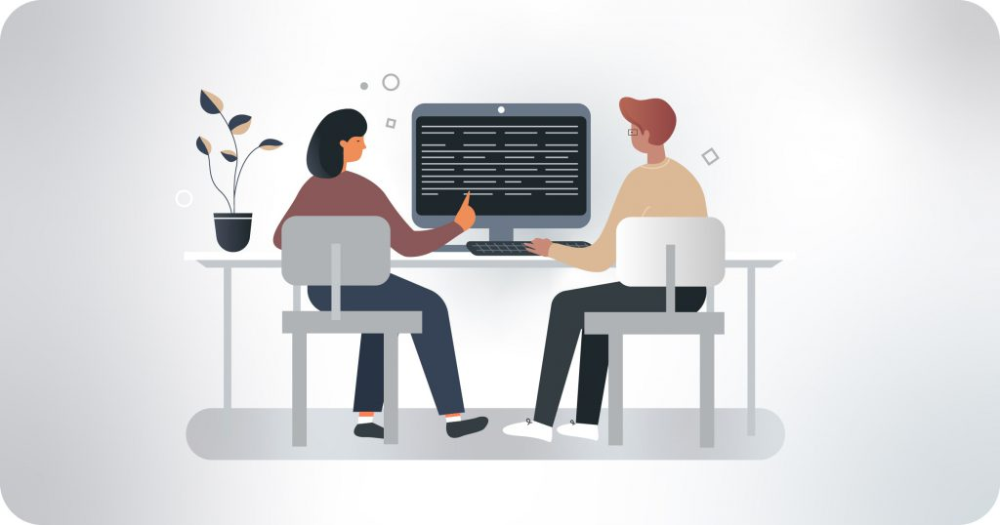


Software Engineering Princple and Practice
Small Releases
Pair programming
Low Coupling
Modularity

Slide 22



Slide 23
System Design

Slide 24
System Architecture
Presentation
UI
Application logic
User Controller
Food Controller
Persistent data
User Info
Food Info
Database

Slide 25
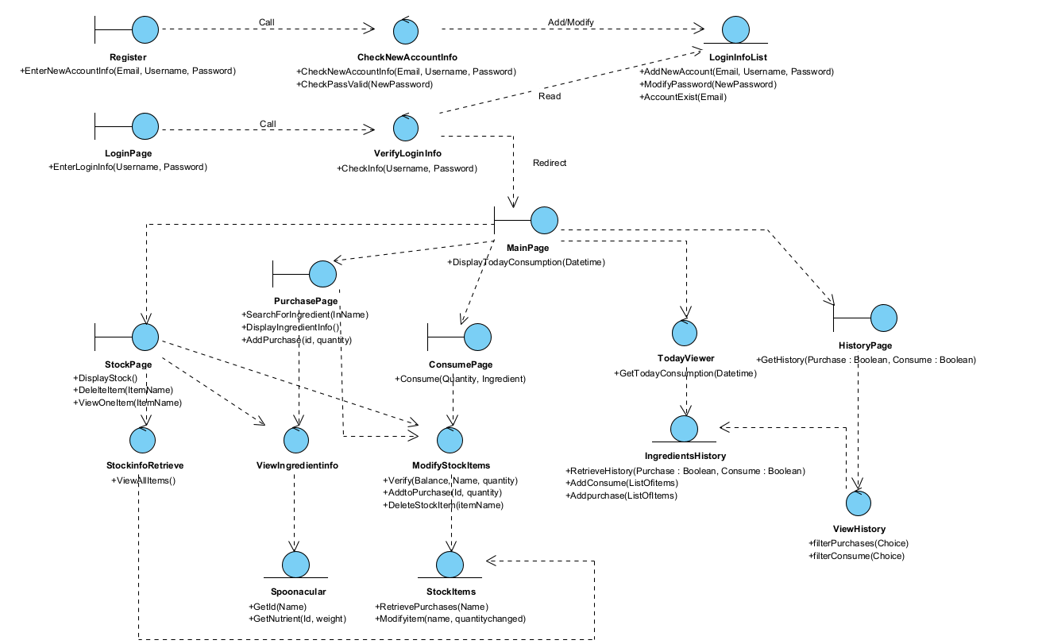

Slide 26
Traceability

Slide 27
Traceability
Use Case:
Register as a new account:
consume food:

Slide 28
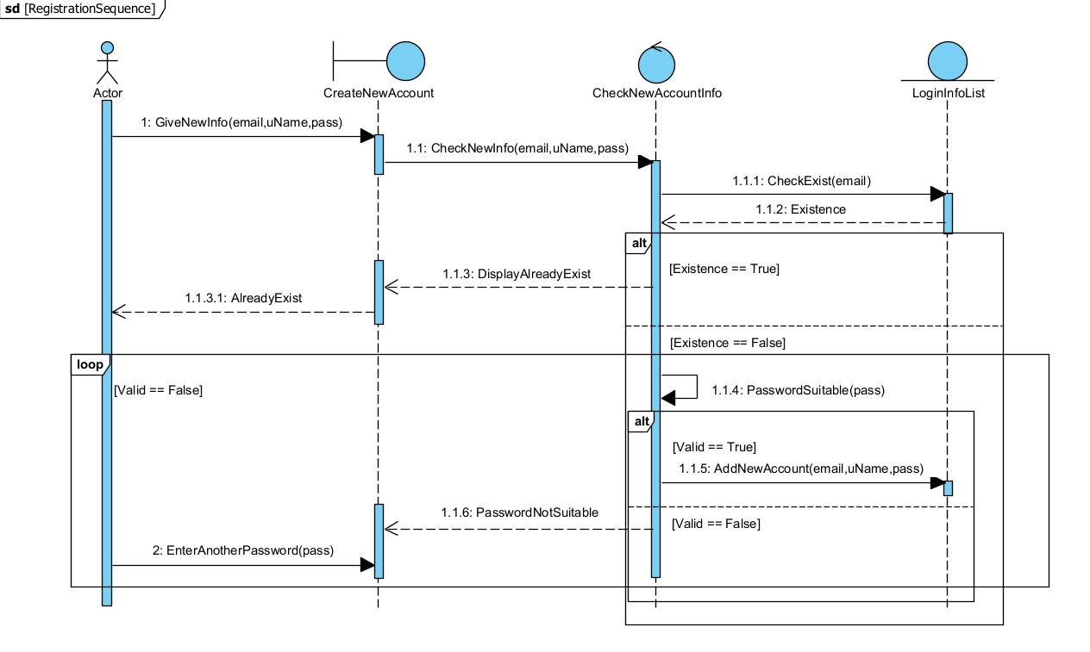
Register a new account
(uName)

Slide 29
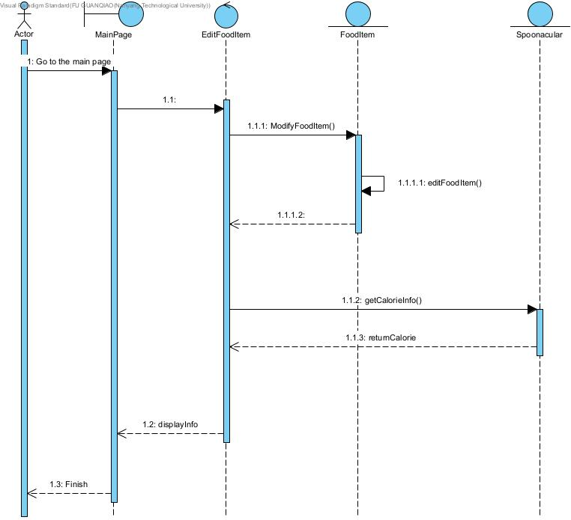
Consume

Slide 30
Test Cases
 | Test Input | Expected Output | Actual Output
1.Register using an existing account: | enter an existing username “test1” | print an error message that tells the user to change username. | an error message has been shown
2.password issue: | enter invalid(‘123’) or unmatched password | return error message and ask reenter. | an error message has been shown
3.consume food: | consume 50g apple from purchased 100g apple. | purchased item quantity changed 50g. the home page show the calories 26. user can view history from “History” Page. | purchased item quantity from 100g to 50g; home page show calories 26; can view in “History” Page

Slide 31


Slide 34
Thank You!

